Slide 1

Introduction
Dr Alveen Singh
Department of Information Technology
Research skills/Project 3A
Advanced Diploma in ICT/B.ICT
Semester 1 2023

Slide 2

Content
Somecards.com
Defining “Research”
Basic types of research
The purpose of research
Research in the field of IT

Slide 3
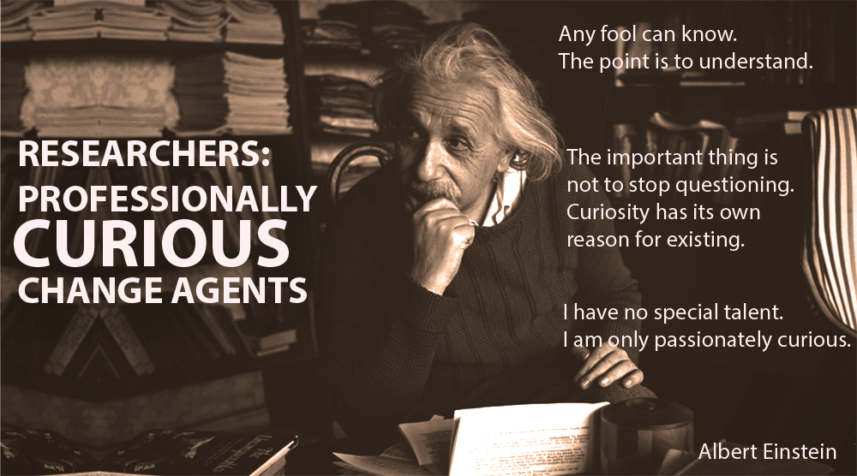
The Research Society

Slide 4
1. Defining “Research”
“a rigorous process of asking question, gathering data, analysing, interpreting, and proposing a response
to the question”
(Kinash, 2017).

Slide 5
“the creation of new knowledge or the use of existing knowledge in a new and creative way so as to generate new concepts, methodologies and understandings”
(University of Western Sydney, 2020).

Slide 6
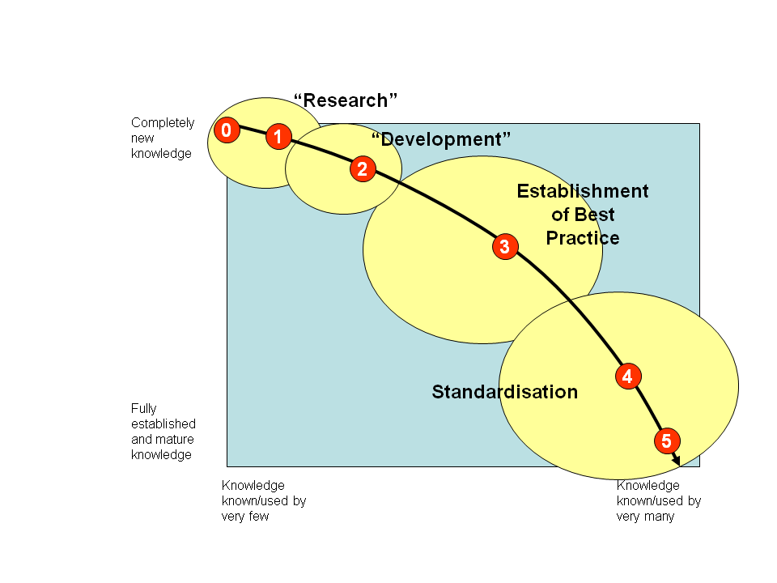
Milton, 2019

Slide 7
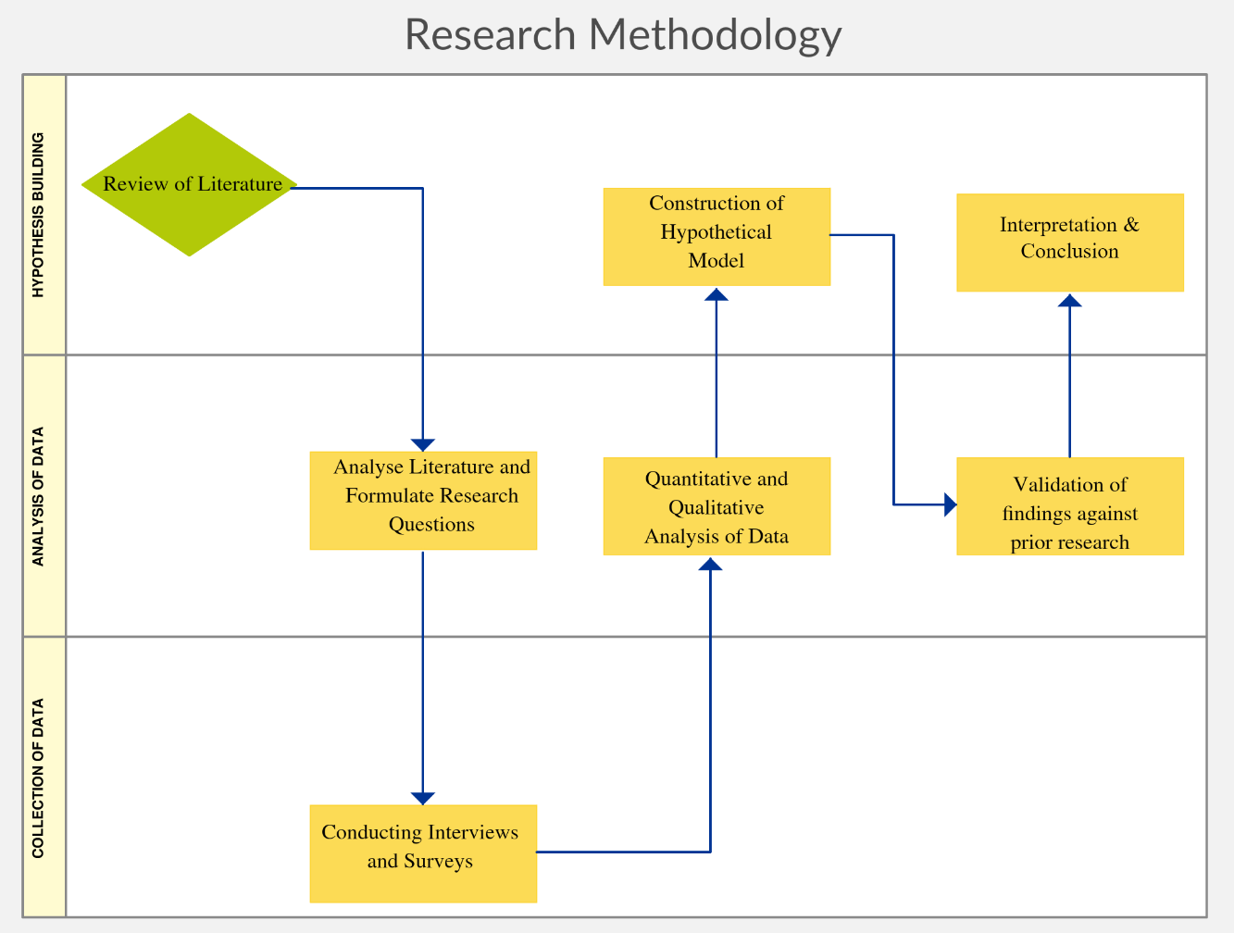
“Any creative systematic activity undertaken in order to increase the stock of knowledge, including knowledge of man, culture and society, and the use of this knowledge to devise new applications”
(OECD Glossary of Statistical Terms – UNESCO Definition, 2007).
Creatly, 2019

Slide 8
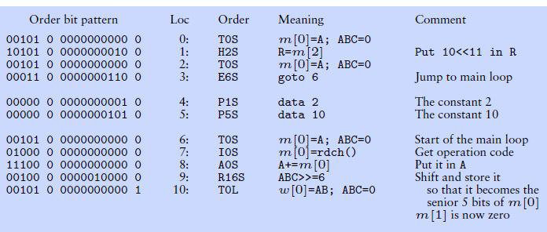
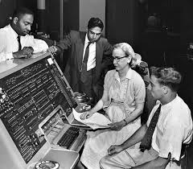
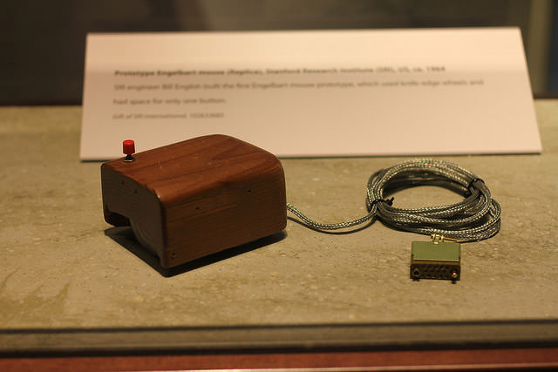
Why are we so concerned with research?
Without research great developments would not be possible like electricity, vaccines, nuclear fission and the internet.
University of Cambridge
Wikimedia, 2019
Hicks via Flickr

Slide 9



Research is the process of asking complicated questions and then systematically working towards an answer to this question
Mad at gravity, 2017
The origin times

Slide 10


Different researchers will arrive at different answers to the same question
These are known as research contributions and collectively, they advance the field

Slide 11
For example,
How can we detect harmful airborne contaminants ?
Manual measure
Advances in wireless sensor technology (WSN)
Training of machine learning algorithms to mimic human perception from safe to hazardous
Automated control systems
advancements

Slide 12
The researcher will:
Pose a research question
Understand the current state (persistent problems, new approaches and their shortcomings)
Collect data (primary or secondary)
Analyze the data
Draw conclusions from the analysis
Answer the research question

Slide 13
2. Types of research
The type of research is determined by the nature of the research question, the type of data to be collected and how it will be analyzed.

Slide 14
Basic research
Contributes to an existing body of knowledge through original results
It is basic in approach
(simple research questions and uncomplicated research methods)
It results in a scientific explanation and conclusion on a research problem

Slide 15
This is IT research
Applied research
It aims to solve a practical problem faced by society, industry or some other significant group.
Experimental research, design research and action research as examples of applied research.
This type of research could result in new techniques, technology products or methodologies.

Slide 16
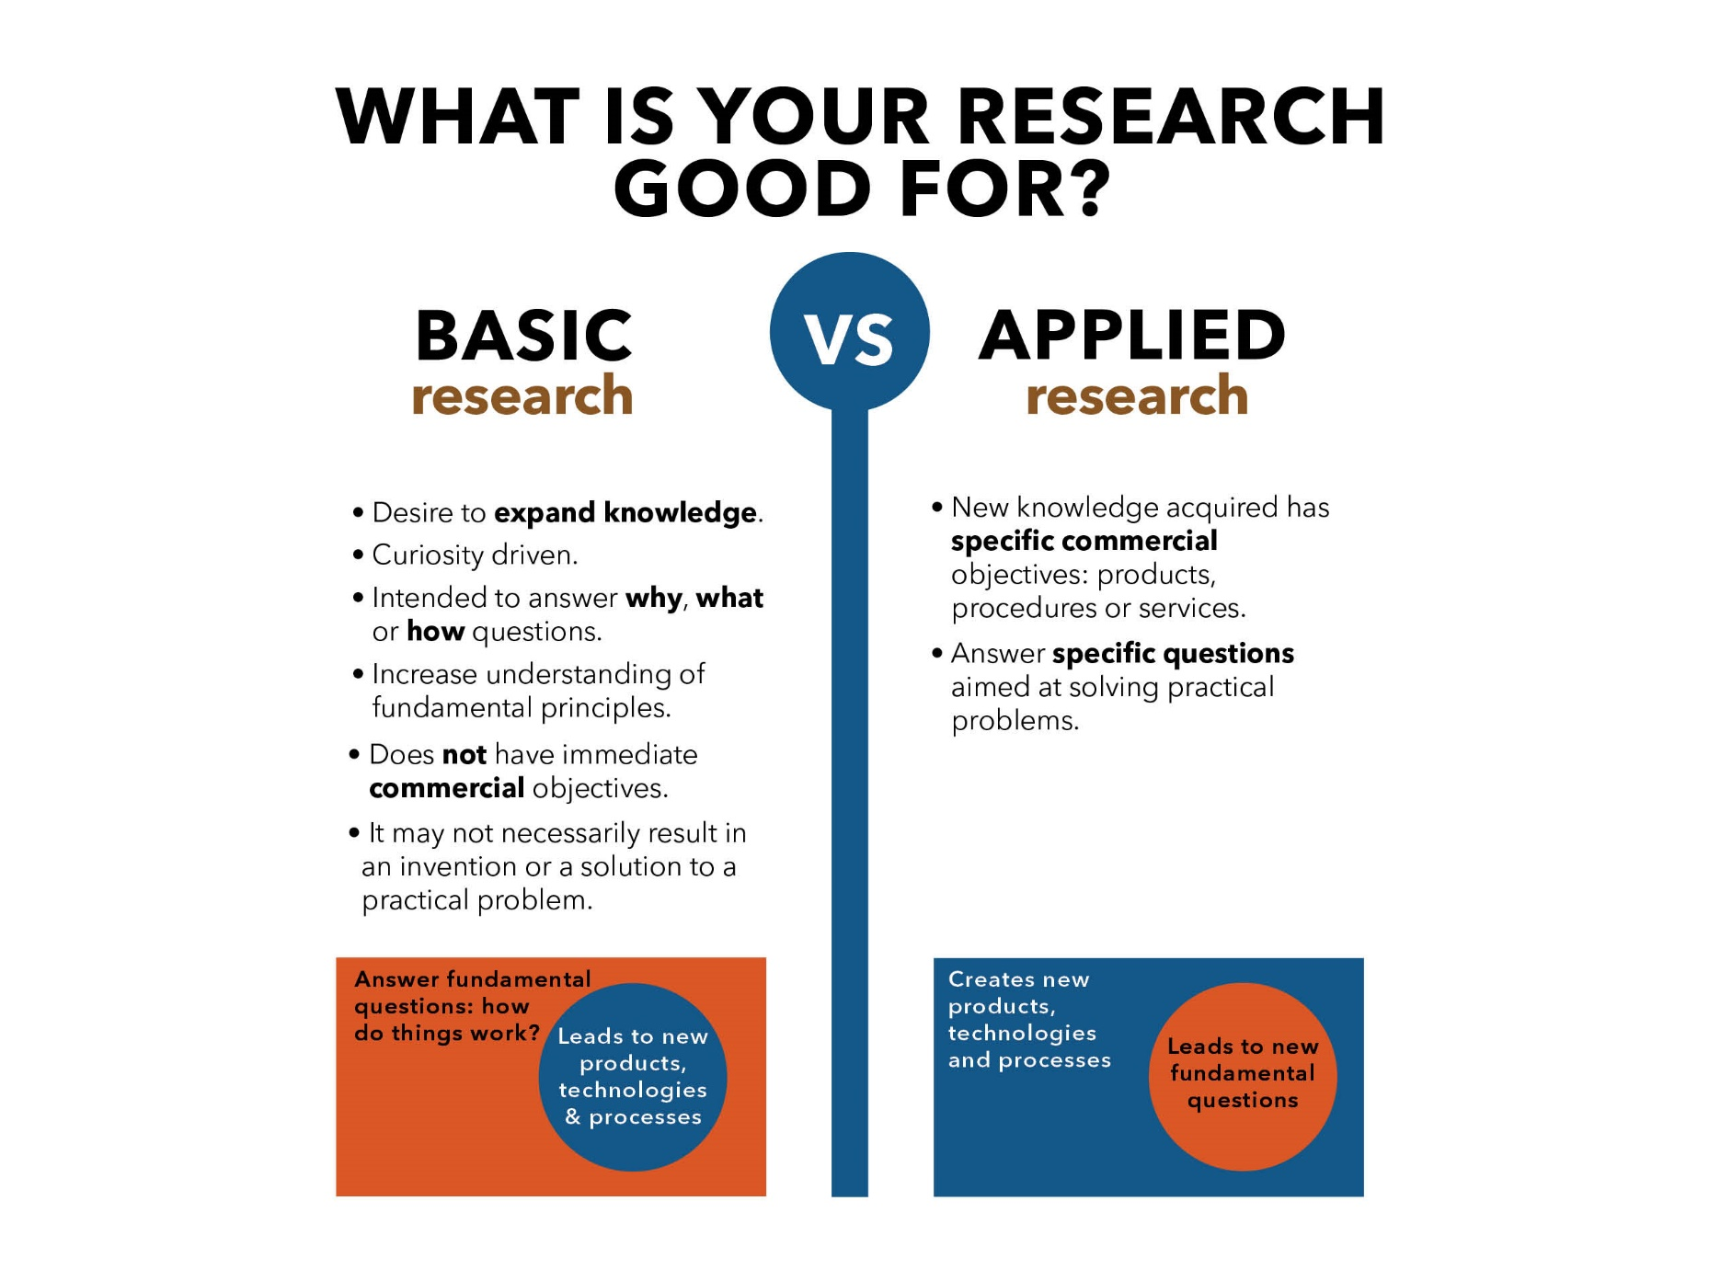
The University of Texas

Slide 17
Problem based research
Aims to understand the nature of a problem
To determine the possible causes of this problem

Slide 18
Qualitative research
Aims at in-depth understanding of problems or issues in their natural settings.
It is non-statistical.
Data is collected from interviews, open-ended questions and observations and other ethnographic techniques

Slide 19
Quantitative research
Uses computational and statistical techniques and calculations to collect and analyse data.
Quantitative research is all about using numbers to prove or arrive at a conclusion.

Slide 20
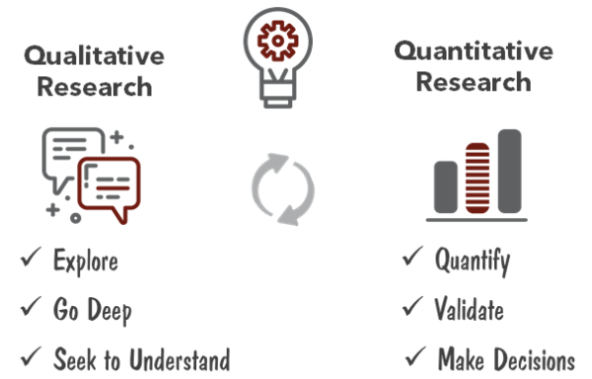
Relevant insights

Slide 21
3. The purpose of research
There are different aims for research.
The research question and objectives guides this selection.

Slide 22
Exploratory research
Aims to establish a better understanding of a research problem.
After this, more focused research questions and objectives can be set.

Slide 23
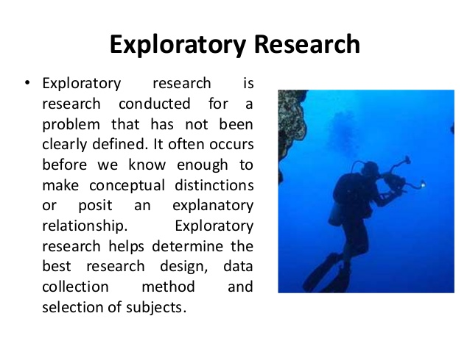
Joy, 2016

Slide 24
Exploratory research
eg: what are the challenges that agile developers face with UX design for mobile apps?
The researcher may conduct interviews, open-ended question surveys or observations to determine these challenges.
This exploratory study will result in a set of identified challenges, some frequent and others unique.
A later study involving statistics and computational methods will allow the researcher to rank, prioritize and summarize challenges in order to draw generalizable conclusions

Slide 25
Explanatory research
Aims to better understand relationships between the variables under research
Experiments
Eg from previous: what is the relationship between agile practice (variable 1) and problem with UX design (variable 2)

Slide 26
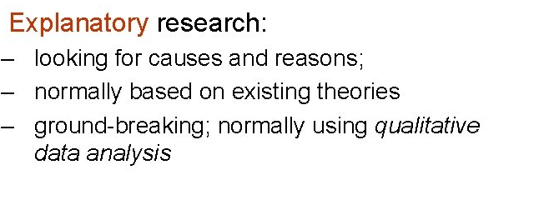
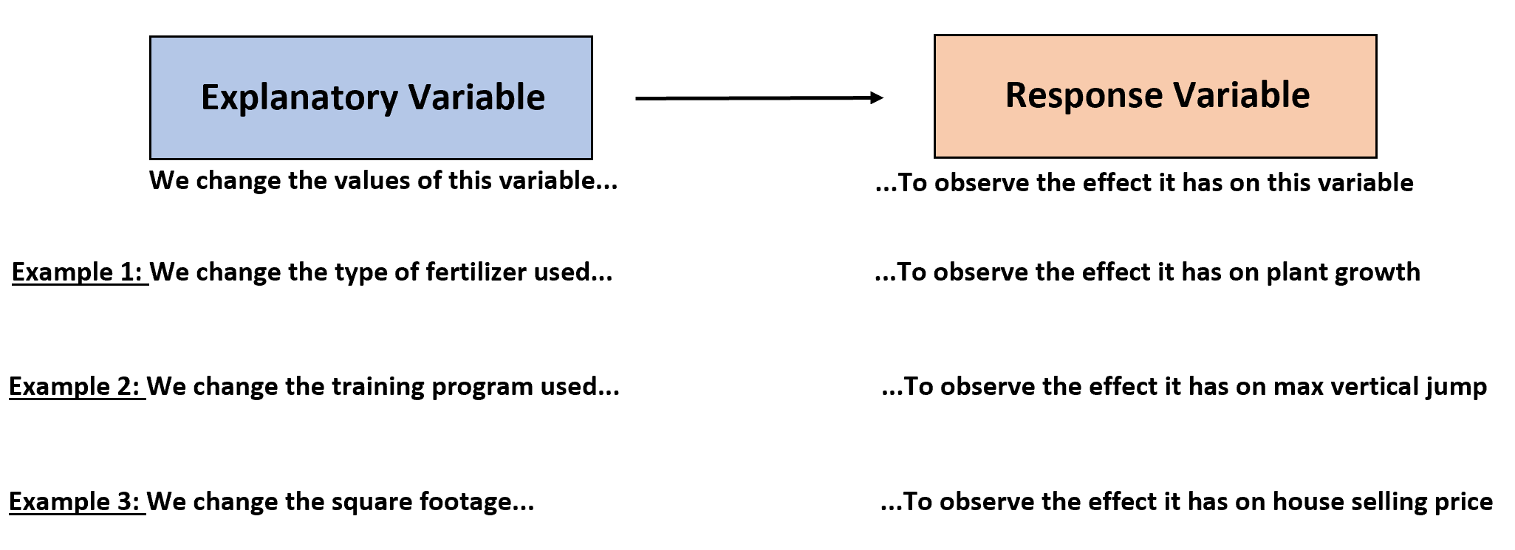
Slidetodoc, 2016
Statology.org, 2020

Slide 27
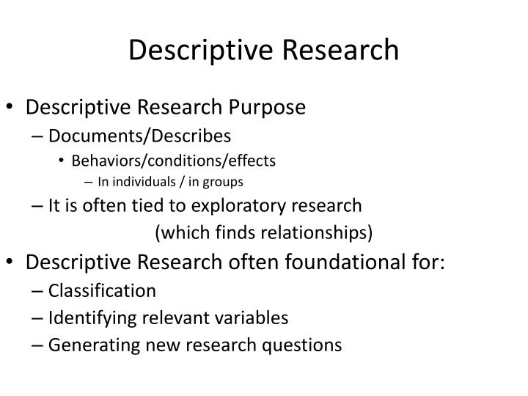
Descriptive research
Aims to describes the characteristics of a problem or group being studied.
directed toward answering questions that begin with,
“What?”
It does not usually answer questions about how, when and why the characteristics came to be
Diaz, 2014

Slide 28
Descriptive research
Eg.
What are the agile practices of a software team developing UX for mobile apps?
This question does not aim to understand any form of cause and effect (Why? And How?)

Slide 29
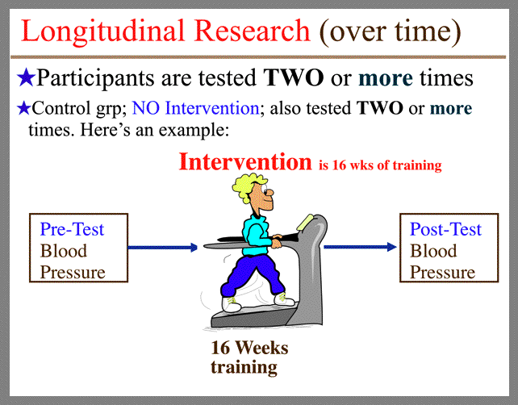
Longitudinal research
Aims to conduct data collection at several points over a long duration.
Eg. the determine the long term effects of smartphone misuse on the future workforce.
The researcher will collect data from participants of the research at intervals over a period of time
unm.edu, 2016

Slide 30
Cross sectional research
Aims to look at how things are now and not pay attention to any trends.
Mostly exploratory or descriptive
Data is collected and analyzed once-off over a short period of fieldwork.
Eg. Determining the causes of Y2K

Slide 31
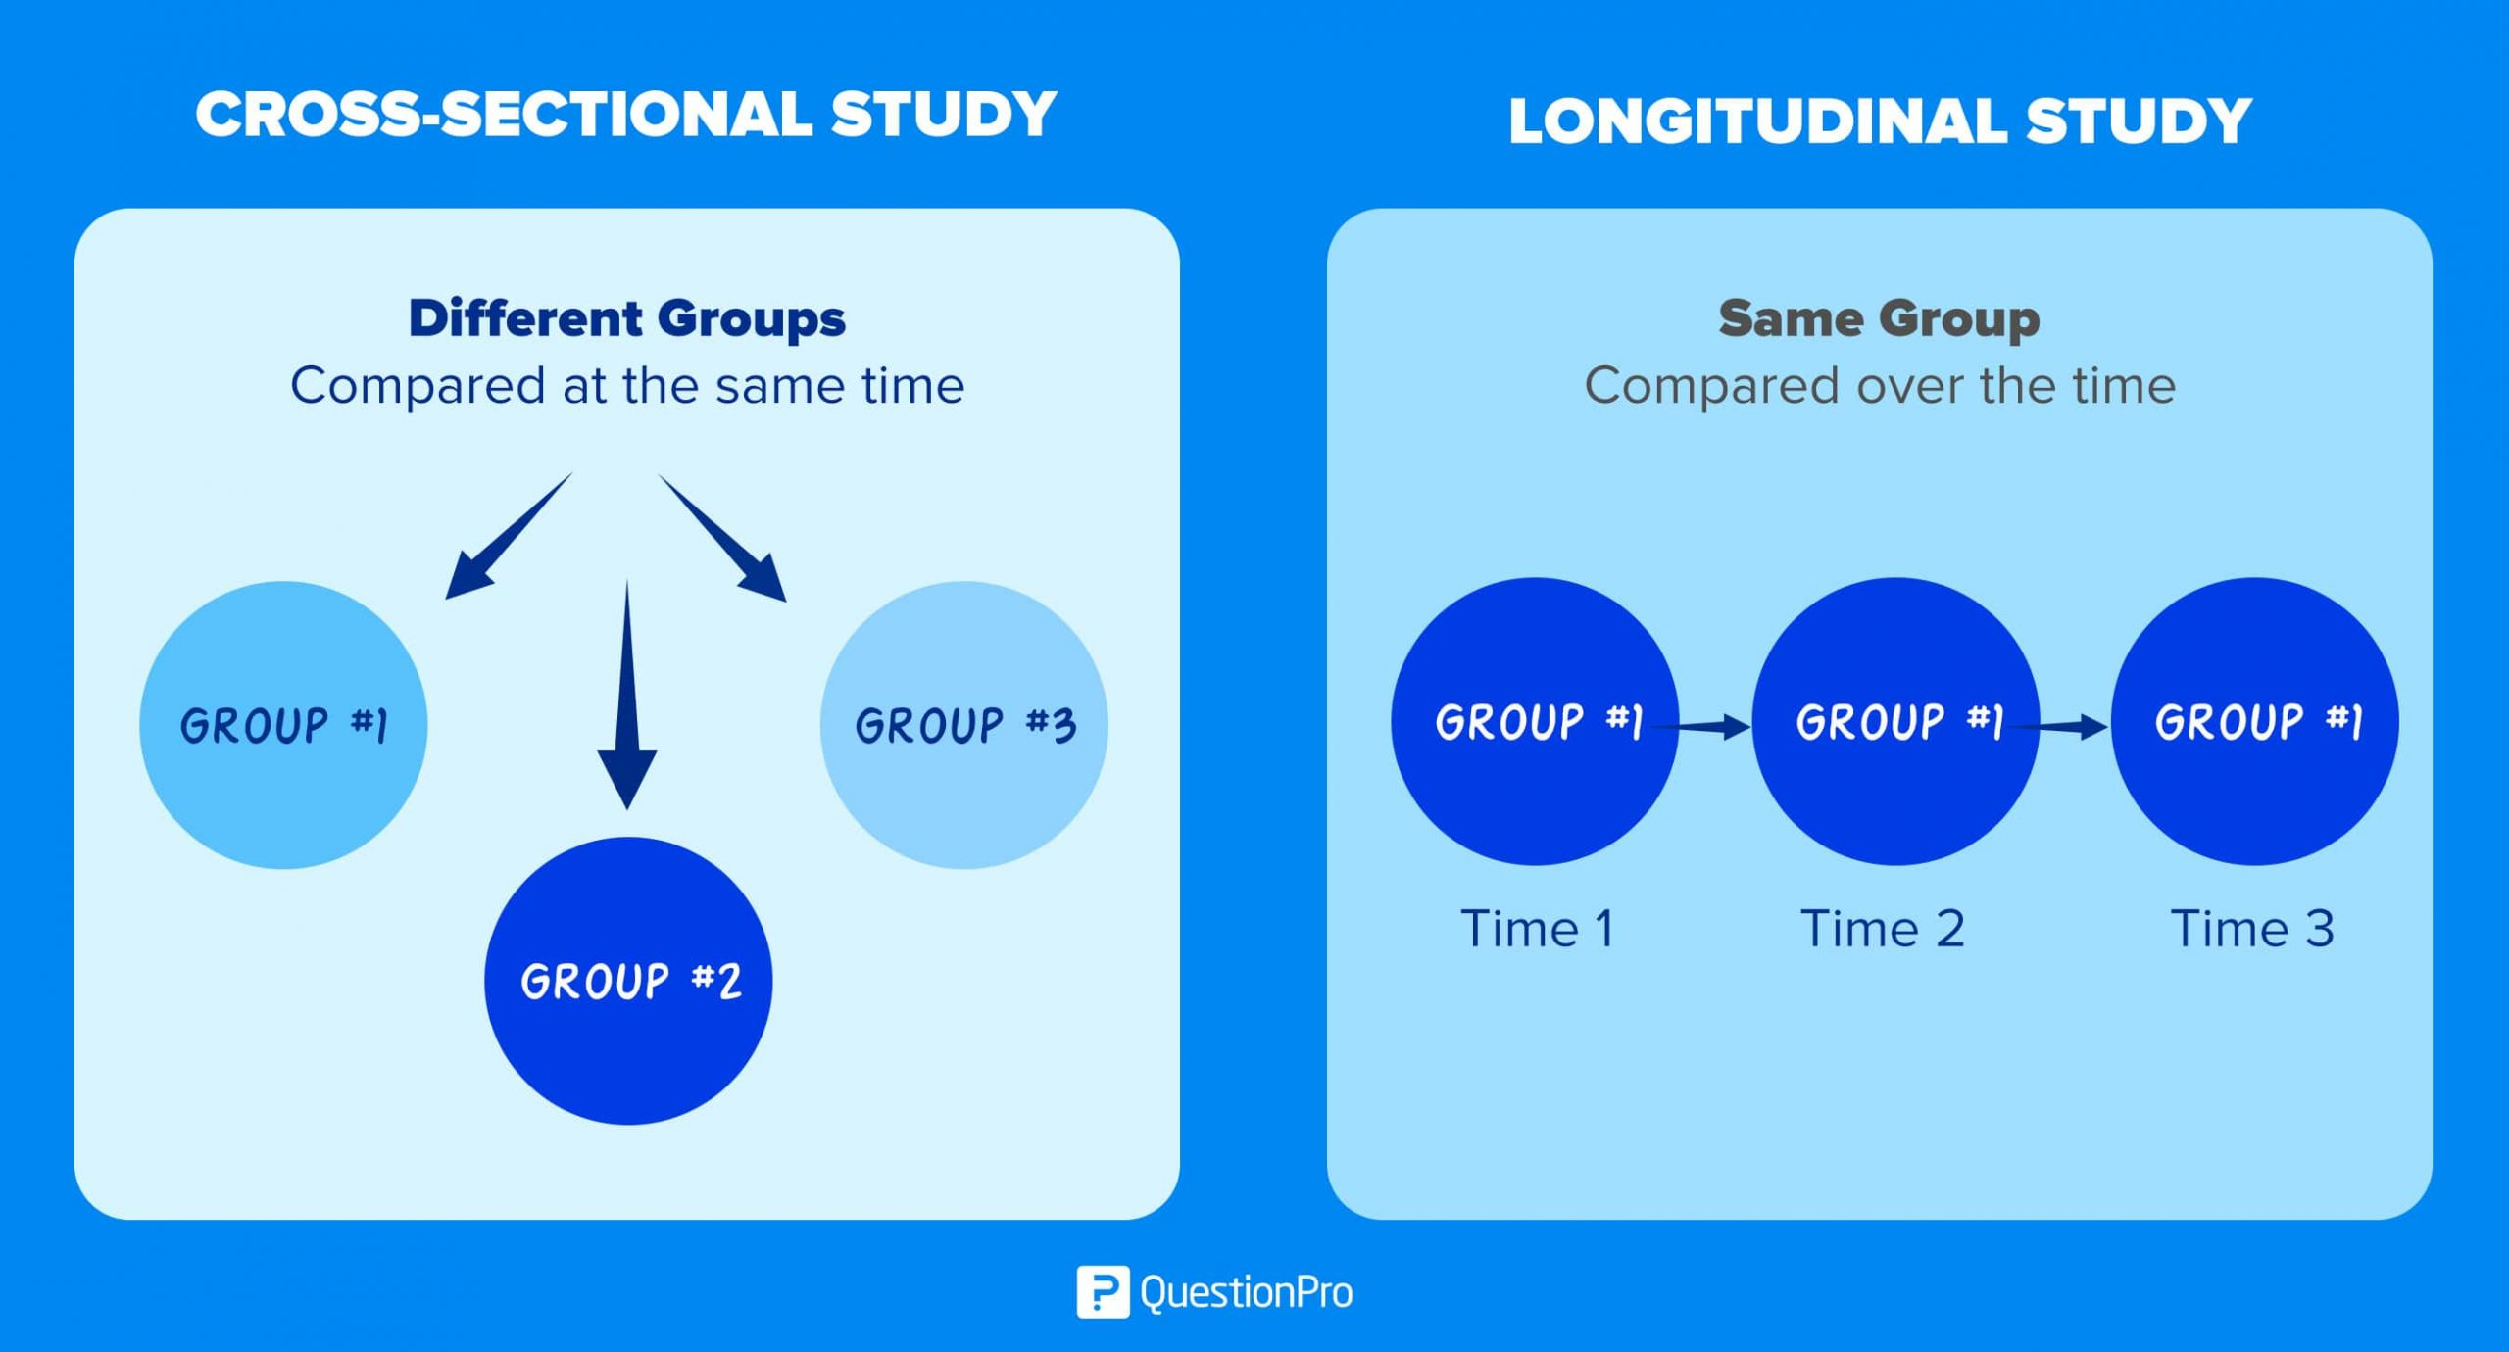
QuestionPro

Slide 32
What are the reasons for doing research?
To add to the body of knowledge
New knowledge may not solve a persistent problem but, it will contribute towards finding one.
To solve a problem
eg. develop a new supervised machine learning algorithm specific to a problem lung cancer detection.
To find evidence to inform practice
How do we? How should we? To discover better methods, models and algorithms.
To develop a better understanding of people as they interact with the world
This is turn helps develop IT solutions that are better suited or fit-for purpose. Eg., improving the UX on mobile devices or removing less used components from a website.
To test or disprove a theory
There are many existing theories. New theories can be formulated. Through a research process theories can be approved or disapproved.
To develop a better way
Improve an existing, well established way to solving a problem e.g. Object orientated programming, agile methodologies

Slide 33

4. Research that has advanced IT
See the lecture note and tutorial
healthitanalytics.com

Slide 34
Please read the lecture note for this section.
Available on Moodle.
Questions and comments are welcome: alveens@dut.ac.za

